Slide 1
Periodic Properties of the Elements

Slide 2
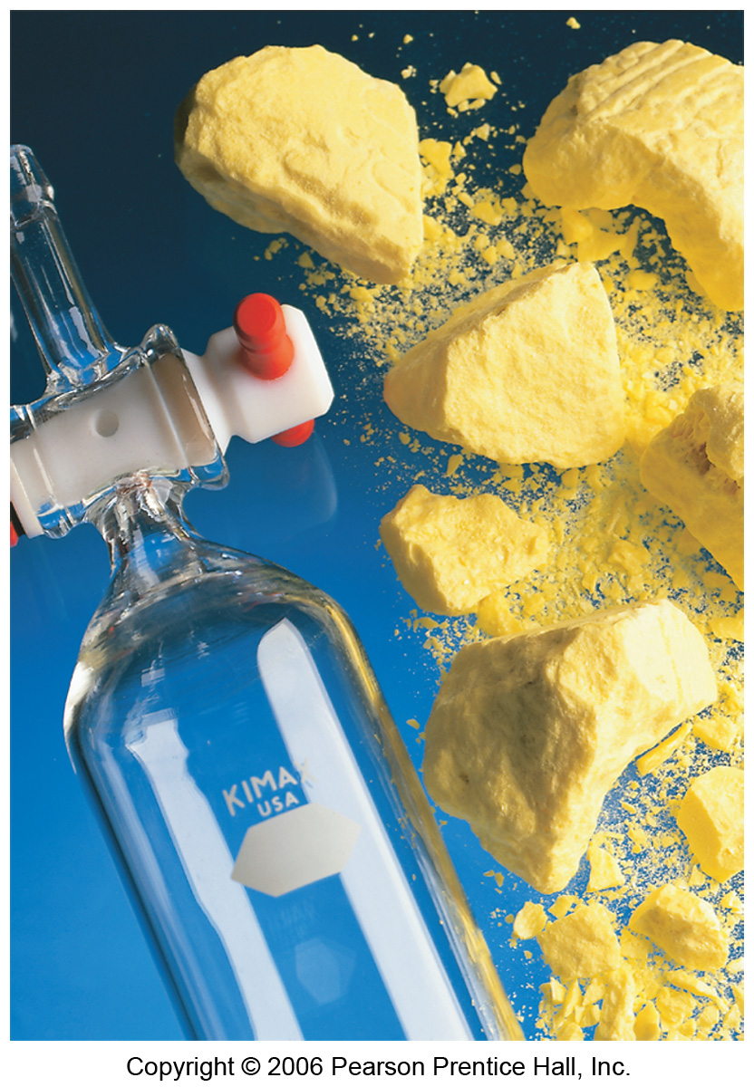
Development of Periodic Table
Elements in the same group generally have similar chemical properties.
Properties are not identical, however.

Slide 3
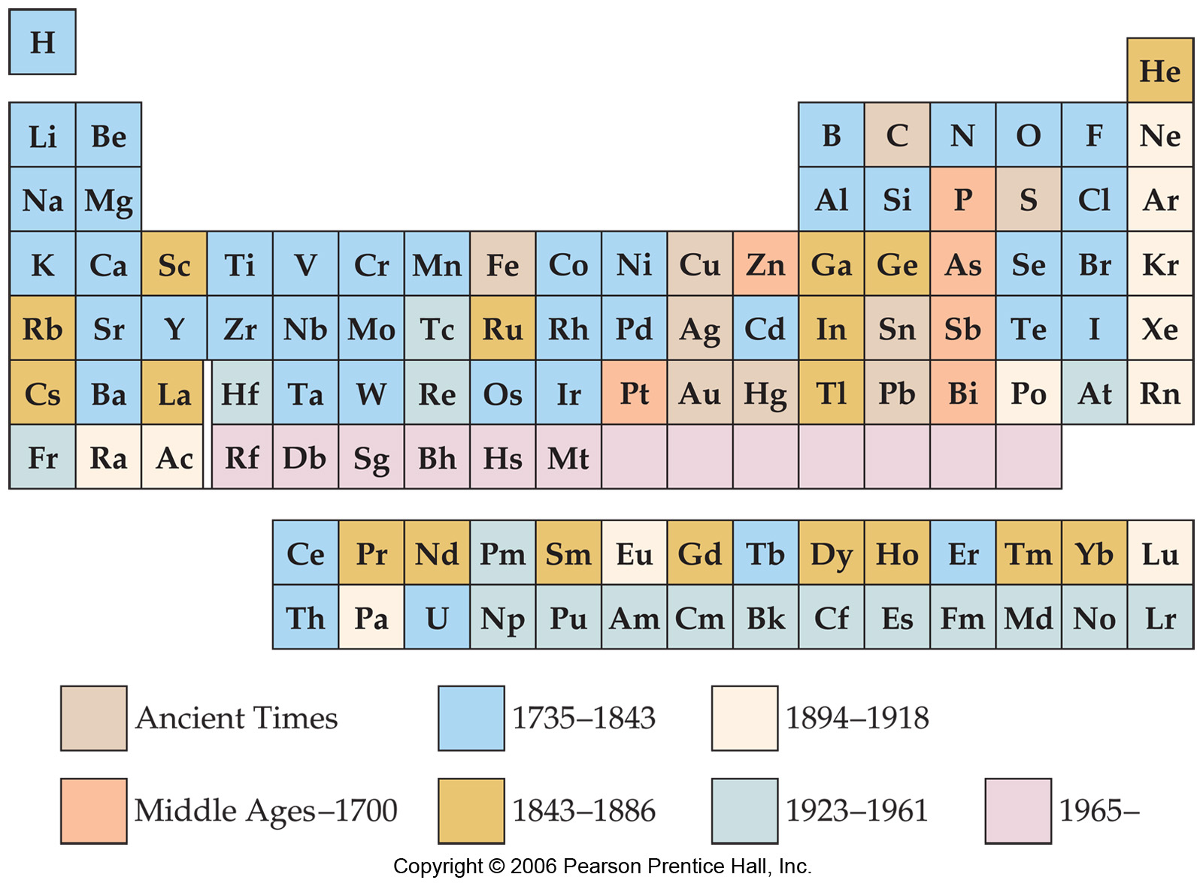
Development of Periodic Table
Dmitri Mendeleev and Lothar Meyer independently came to the same conclusion about how elements should be grouped.

Slide 4
Development of Periodic Table
Mendeleev, for instance, in 1871 predicted germanium (which he called eka-silicon) to have an atomic weight between that of zinc and arsenic, but with chemical properties similar to those of silicon.

Slide 5
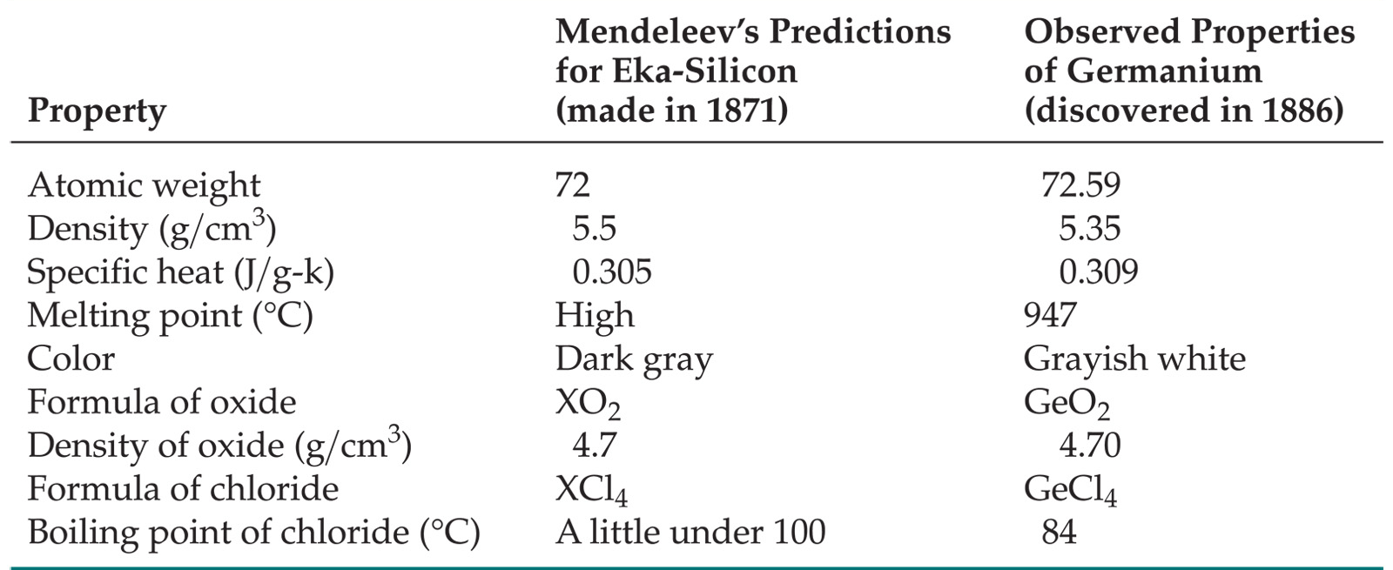
Development of Periodic Table
Mendeleev’s prediction was on the money
But why? (Mendeleev had no clue).

Slide 6
Periodic Trends
In this chapter we’ll explain why
We’ll then rationalize observed trends in
Sizes of atoms and ions.
Ionization energy.
Electron affinity.

Slide 7
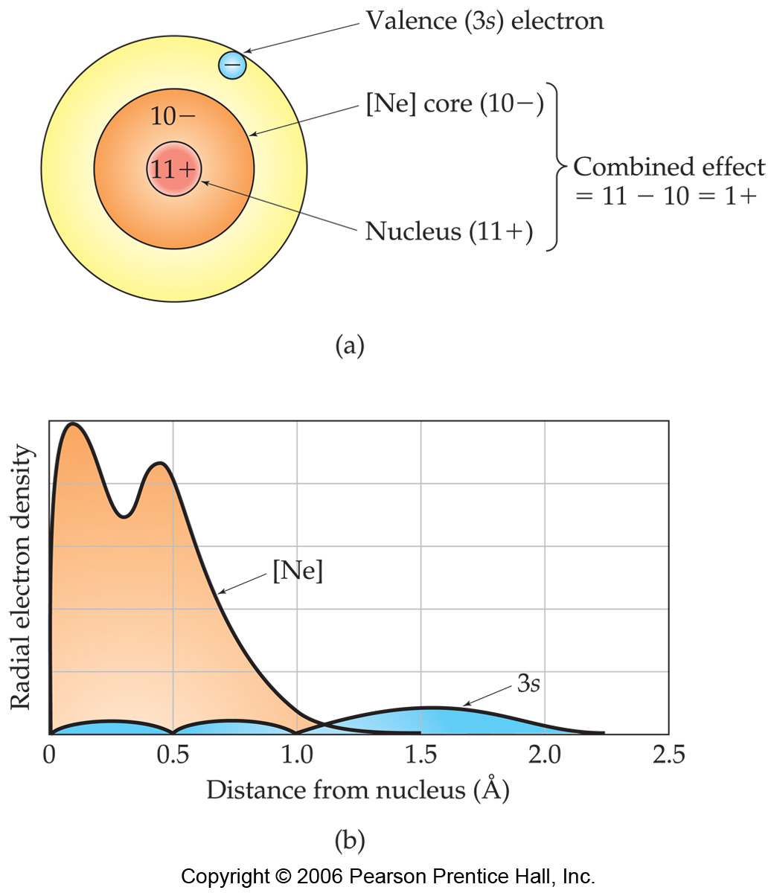
Effective Nuclear Charge
In a many-electron atom, electrons are both attracted to the nucleus and repelled by other electrons.
The nuclear charge that an electron “feels” depends on both factors.
It’s called Effective nuclear charge.
electrons in lower energy levels “shield” outer electrons from positive charge of nucleus.
Na atom looks like this:

Slide 8
Effective Nuclear Charge
Na
The effective nuclear charge, Z_{eff}, is:
Z_{eff} = Z − S
Where:
Z = atomic number
S = screening constant, usually close to the number of inner (n-1) electrons.

Slide 9
Effective Nuclear Charge
Example: Which element’s outer shell or “valence” electrons is predicted to have the largest Effective nuclear charge? Kr, Cl or O?

Slide 10
Effective Nuclear Charge
Example: Which element’s outer shell or “valence” electrons is predicted to have the largest Effective nuclear charge? Kr, Cl or O?
Cl: Z_{eff} ≈ 17 - 10 = 7
O: Z_{eff} ≈ 8 - 2 = 6
N: Z_{eff} ≈ 7 - 2 = 5
Ca: Z_{eff} ≈ 20 - 18 = 2

Slide 11
Valence electrons
Many chemical properties depend on the valence electrons.
Valence electrons: The outer electrons, that are involved in bonding and most other chemical changes of elements.
Rules for defining valence electrons.
In outer most energy level (or levels)
For main group (representative) elements (elements in s world or p world) electrons in filled d or f shells are not valence electrons
For transition metals, electrons in full f shells are not valence electrons.

Slide 12
Valence electrons
Many chemical properties depend on the valence electrons.
Valence electrons: The outer electrons, that are involved in bonding and most other chemical changes of elements.
Rules for defining valence electrons.
In outer most energy level (or levels)
For main group (representative) elements (elements in s world or p world) electrons in filled d or f shells are not valence electrons
For transition metals, electrons in full f shells are not valence electrons.
Examples: (valence electrons in blue)
P: [Ne]3s²3p³
As: [Ar] 4s²3d¹⁰4p3
I: [Kr]5s²4d¹⁰5p⁵
Ta: [Kr]6s²4f¹⁴5d³
Zn: [Ar]4s²3d¹⁰

Slide 13
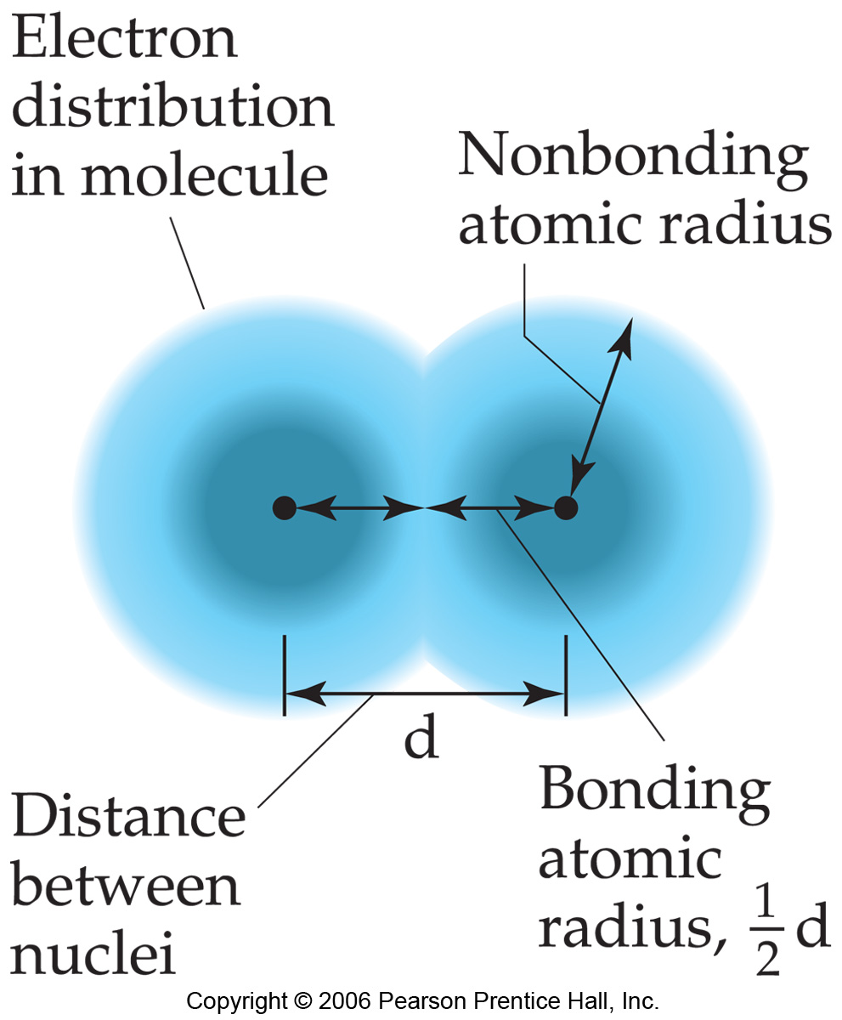
Sizes of Atoms
The bonding atomic radius is defined as one-half of the distance between covalently bonded nuclei.

Slide 14
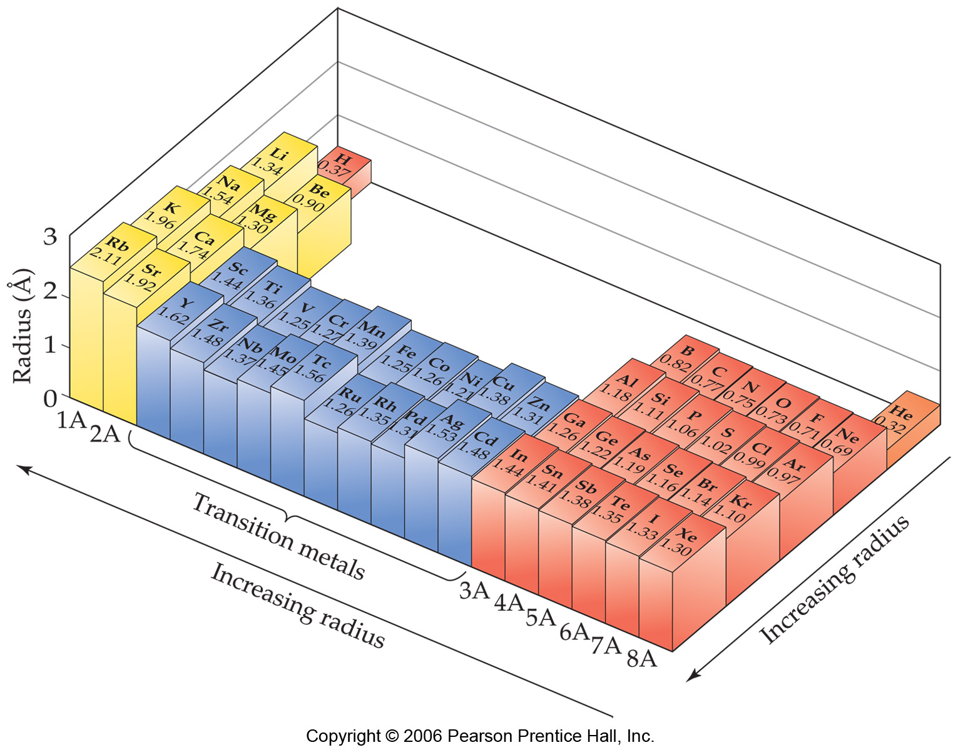
Sizes of Atoms
increasing E_{ff}
increasing n
Bonding atomic radius tends to…
…decrease from left to right across a row due to increasing Z_{eff}.
…increase from top to bottom of a column due to increasing value of n

Slide 15
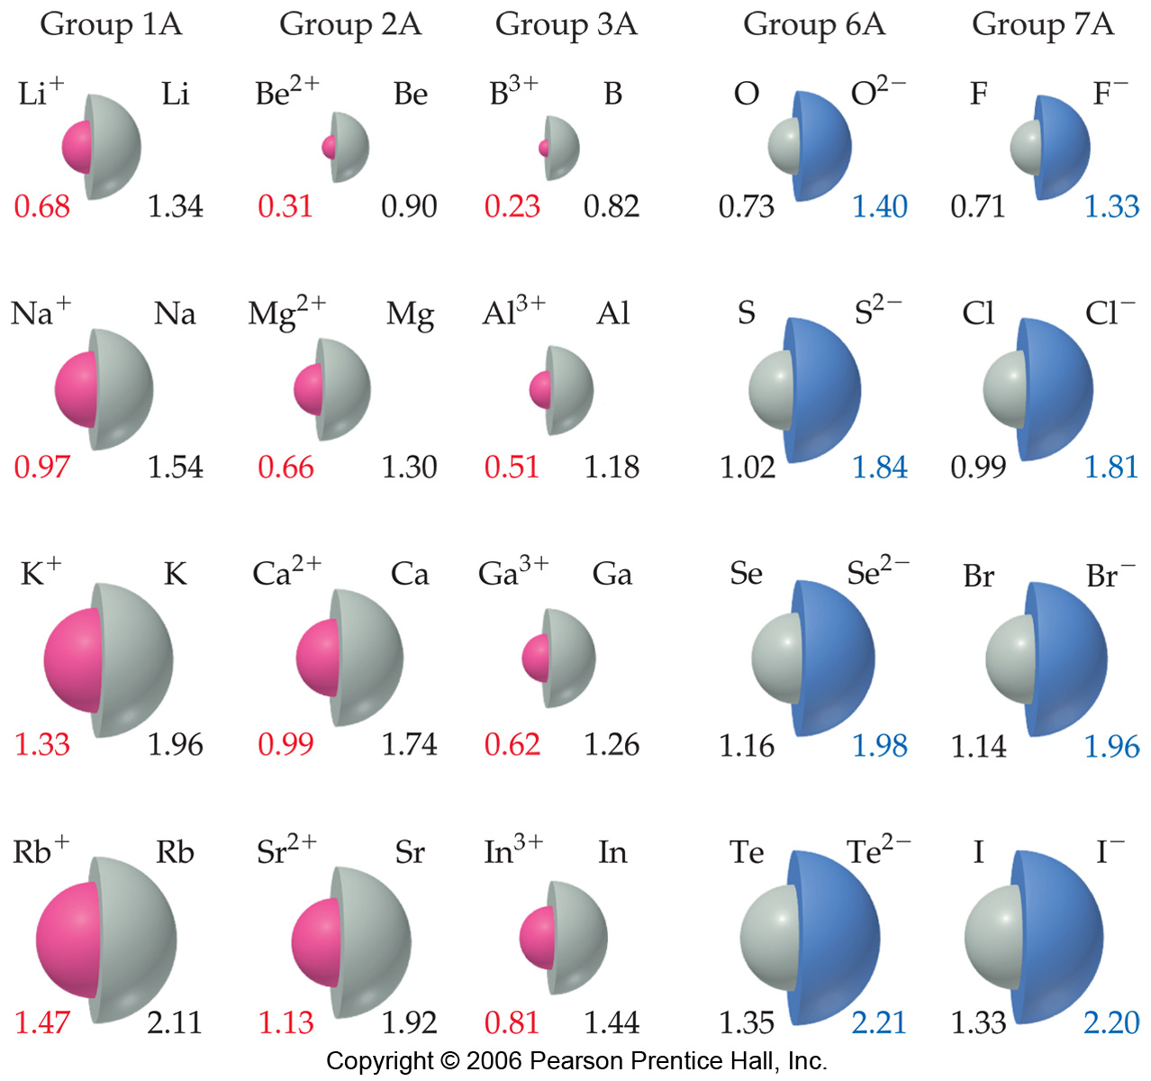
Sizes of Ions
Ionic size depends upon:
Nuclear charge.
Number of electrons.
Orbitals in which electrons reside.

Slide 16
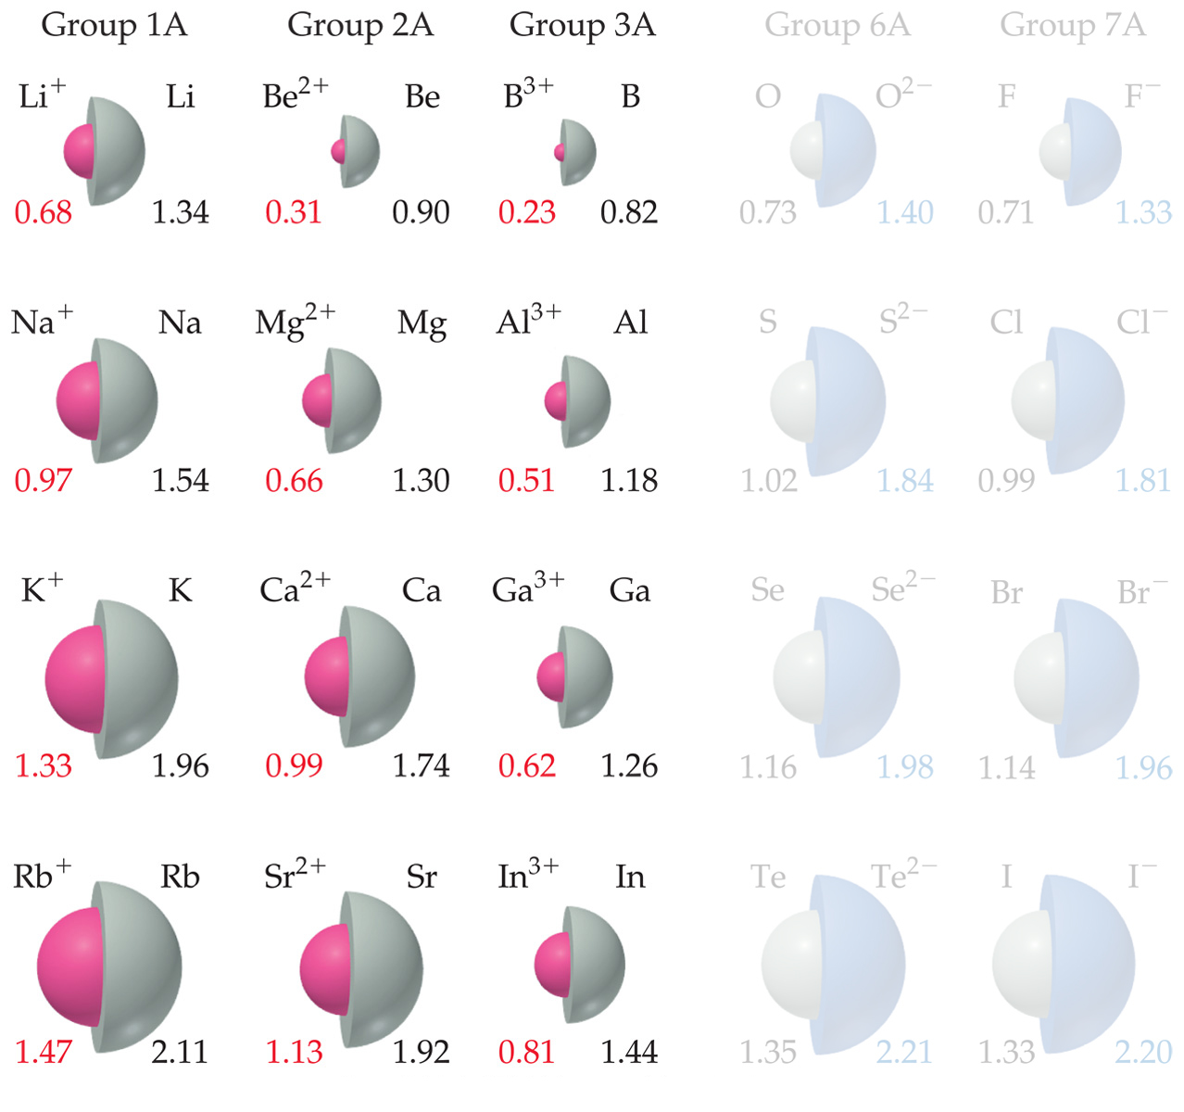
Sizes of Ions
Cations are smaller than their parent atoms.
The outermost electron is removed and repulsions are reduced.

Slide 17
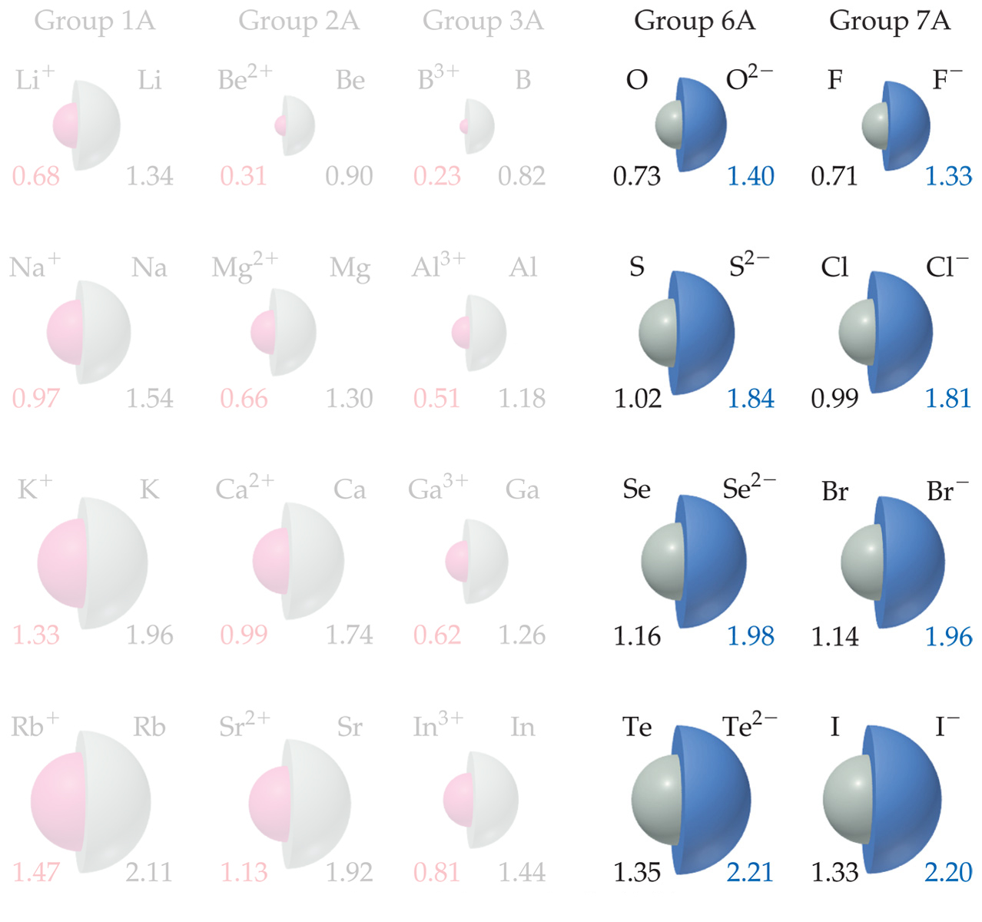
Sizes of Ions
Anions are larger than their parent atoms.
Electrons are added and repulsions are increased.

Slide 18
Sizes of Ions
Ions increase in size as you go down a column.
Due to increasing value of n.

Slide 19
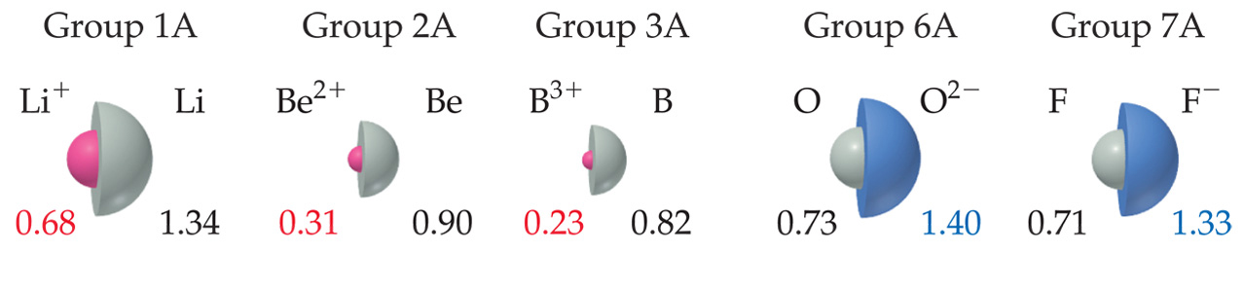
Sizes of Ions
In an isoelectronic series, ions have the same number of electrons.
Ionic size decreases with an increasing nuclear charge.

Slide 20
atom/ion size examples
Put the following in order of size, smallest to largest:
Na, Na⁺, Mg, Mg²⁺, Al, Al³⁺, S, S²⁻, Cl, Cl⁻

Slide 21
Atom size examples
Al³⁺, Mg²⁺, Na⁺, Cl, S, Al, Mg, Na, Cl⁻, S²⁻
Start with atoms with no n=3 electrons, order isoelectronic by nuclear charge.
Next, neutral atoms highest E_{ff} first
Last, anions, highest E_{ff} first
Ambiguity: anions versus neutrals (is Cl⁻ really larger than Na?)
Don’t worry about it.

Slide 22
Ionization Energy
Amount of energy required to remove an electron from the ground state of a gaseous atom or ion.
First ionization energy is that energy required to remove first electron.
Second ionization energy is that energy required to remove second electron, etc.
El -------> El⁺ + e⁻
Na -------> Na⁺ + e⁻

Slide 23
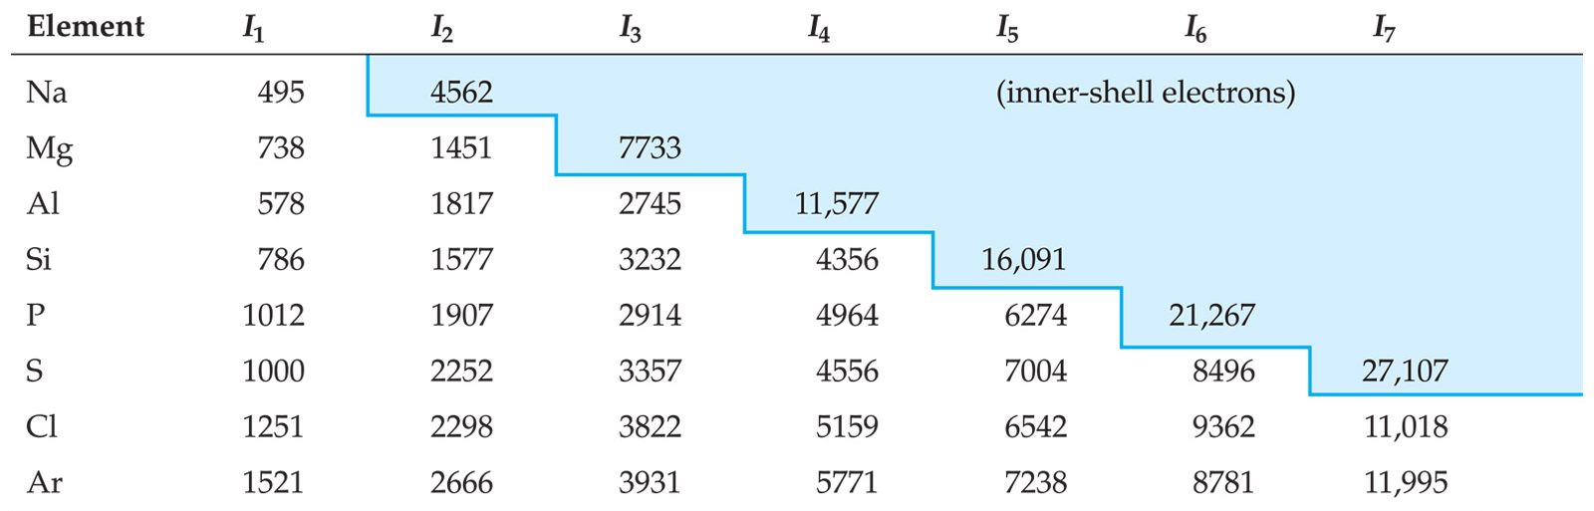
Ionization Energy
It requires more energy to remove each successive electron.
When all valence electrons have been removed, the ionization energy takes a quantum leap.

Slide 24
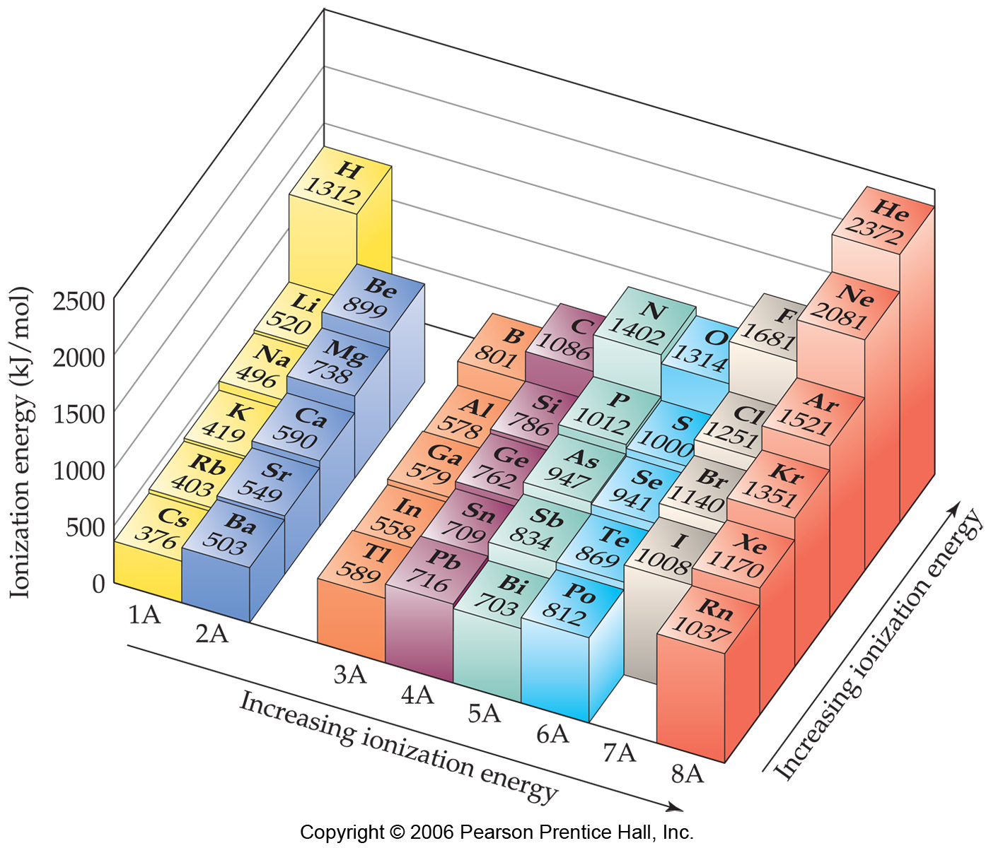
Trends in First Ionization Energies
going down a column, less energy to remove the first electron.
For atoms in the same group, Z_{eff} is essentially the same, but the valence electrons are farther from the nucleus.

Slide 25
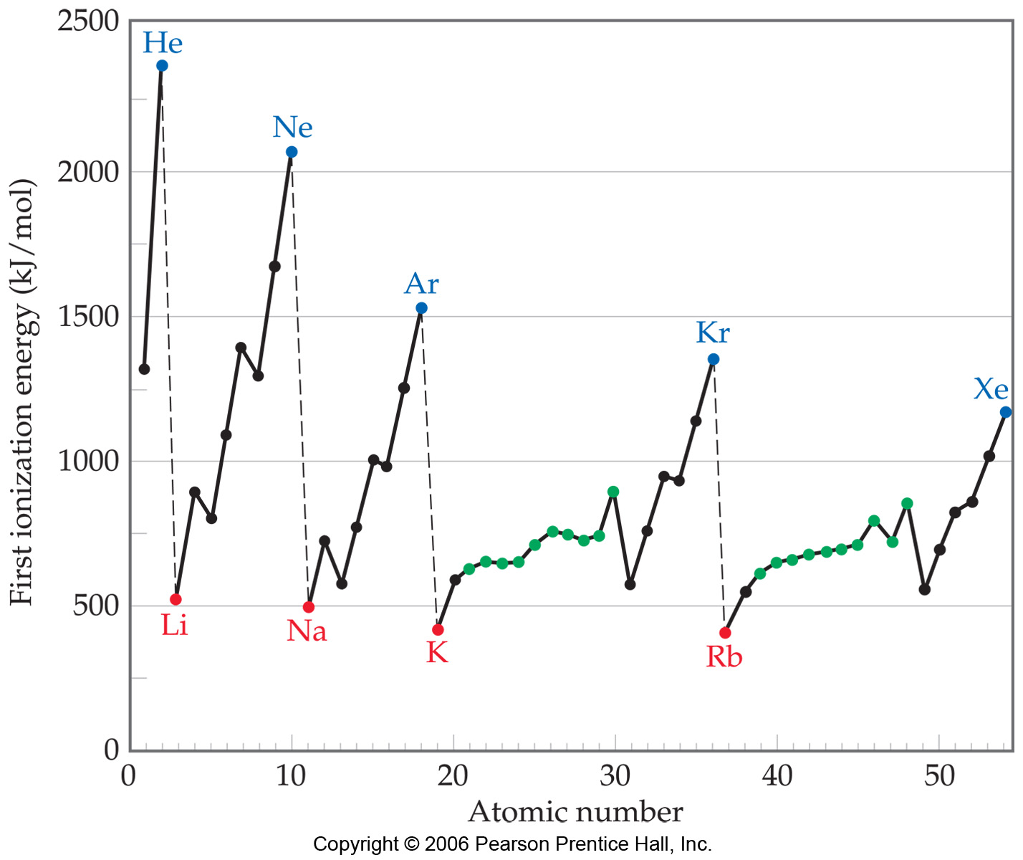
Trends in First Ionization Energies
Generally, it gets harder to remove an electron going across.
As you go from left to to right, Z_{eff} increases.

Slide 26
Trends in First Ionization Energies
On a smaller scale, there are two jags in each line. Why?

Slide 27
Trends in First Ionization Energies
The first occurs between Groups IIA and IIIA.
Electron removed from p-orbital rather than s-orbital
Electron farther from nucleus
Small amount of repulsion by s electrons.

Slide 28
Trends in First Ionization Energies
The second occurs between Groups VA and VIA.
Electron removed comes from doubly occupied orbital.
Repulsion from other electron in orbital helps in its removal.
versus:

Slide 29
Electron Affinity
Energy change accompanying addition of electron to gaseous atom:
Cl + e⁻ ⎯⎯→ Cl⁻

Slide 30
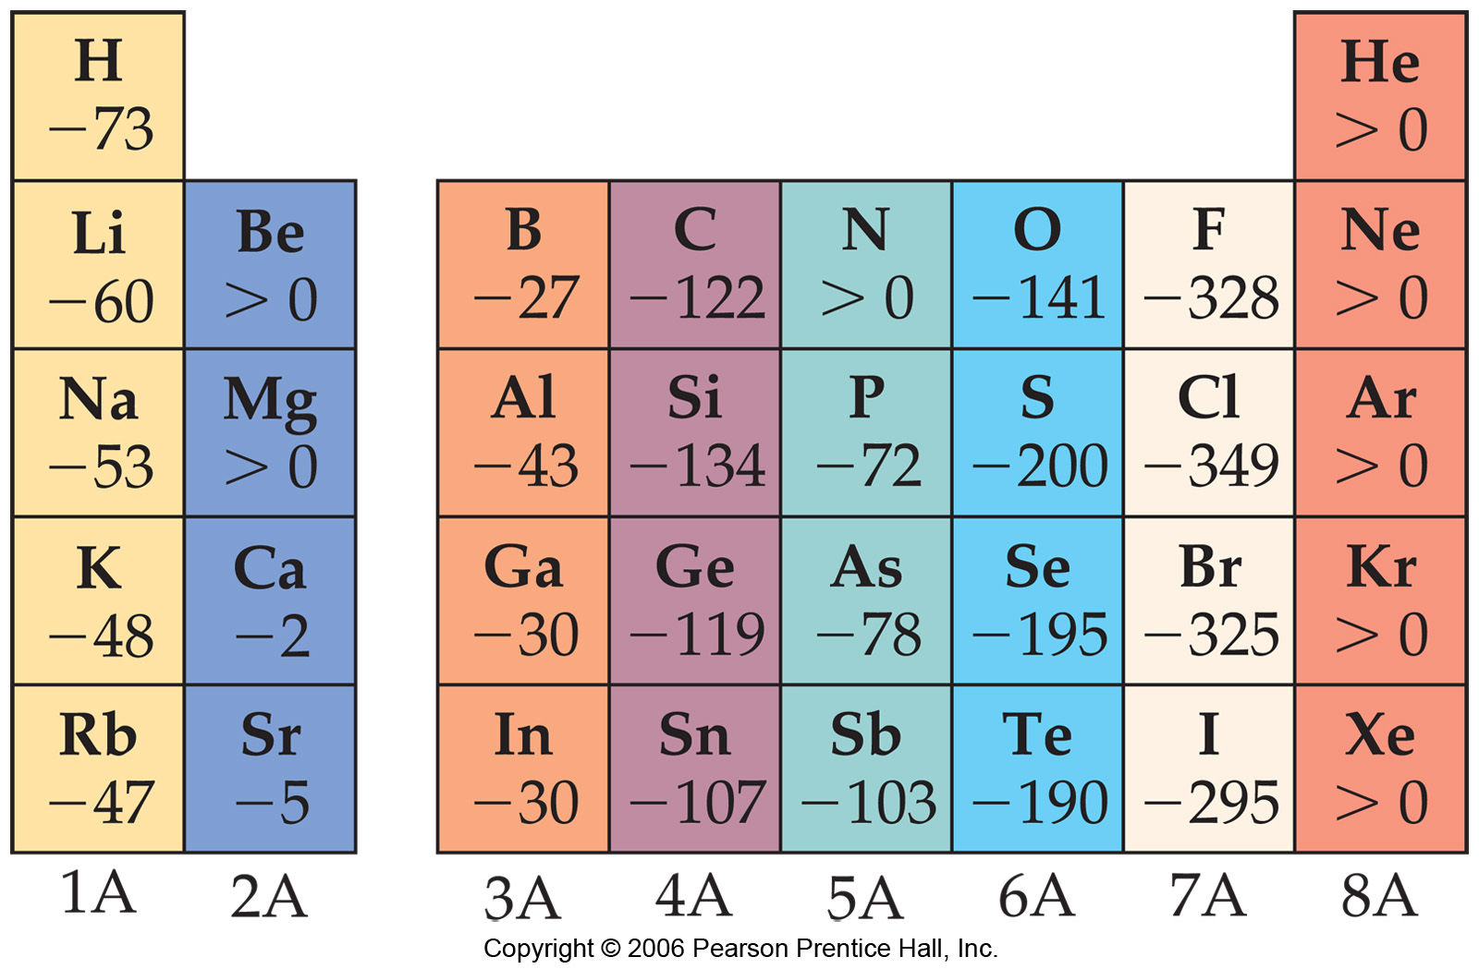
Trends in Electron Affinity
In general, electron affinity becomes more exothermic as you go from left to right across a row.

Slide 31
Trends in Electron Affinity
There are also two discontinuities in this trend.

Slide 32
Trends in Electron Affinity
The first occurs between Groups IA and IIA.
Added electron must go in p-orbital, not s-orbital.
Electron is farther from nucleus and feels repulsion from s-electrons.

Slide 33
Trends in Electron Affinity
The second occurs between Groups IVA and VA.
Group VA has no empty orbitals.
Extra electron must go into occupied orbital, creating repulsion.

Slide 34
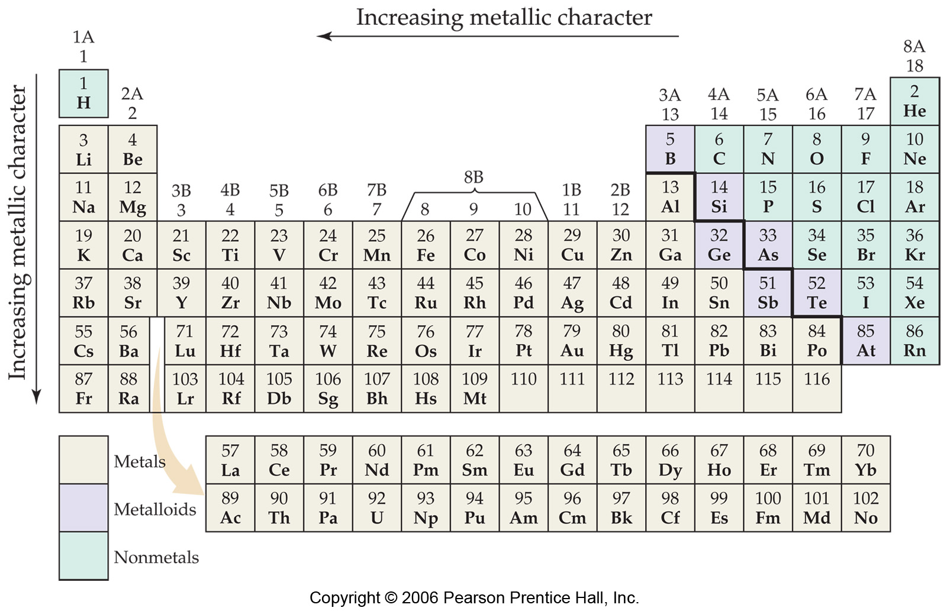
Properties of Metals, Nonmetals, and Metalloids

Slide 35
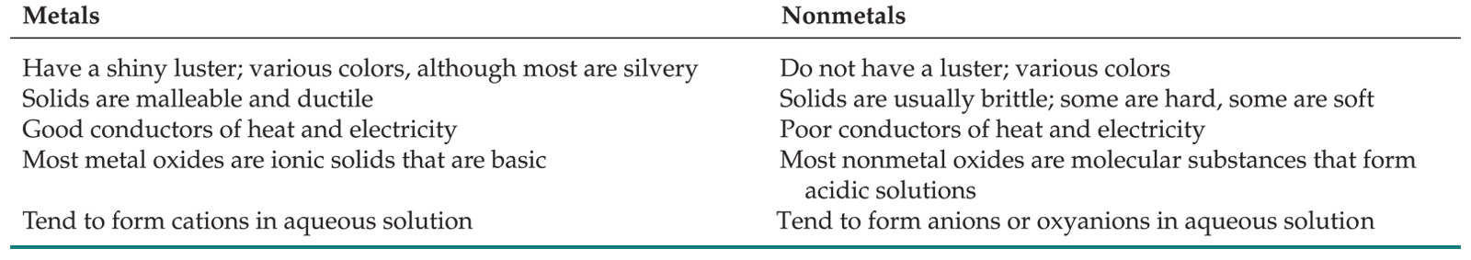
Metals versus Nonmetals
Differences between metals and nonmetals tend to revolve around these properties.

Slide 36
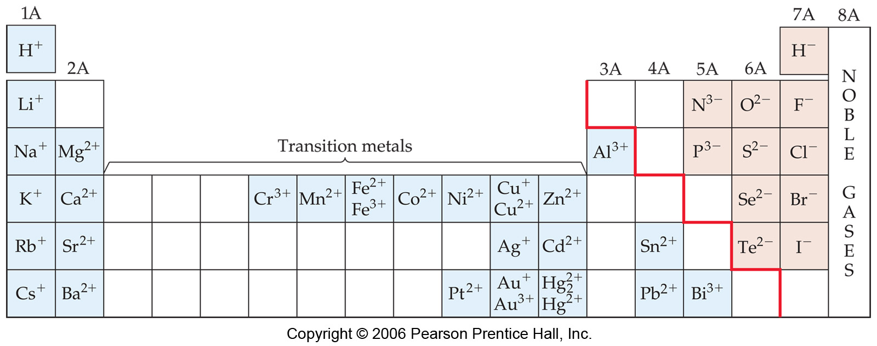
Metals versus Nonmetals
Metals tend to form cations.
Nonmetals tend to form anions.
The common elemental ions
Note ions in s and p world all result from filling or empyting a subshell.
What about the transition metals? What’s going on there?

Slide 37
Transition Metal ions
Note: many have +2 charge.
They actually lose all their ns electrons first!
Mn --> Mn²⁺: [Ar]4s²3d⁵ ---> [Ar]3d⁵
Cu --> Cu⁺ [Ar]4s²3d⁹ ---> [Ar]3d¹⁰

Slide 38
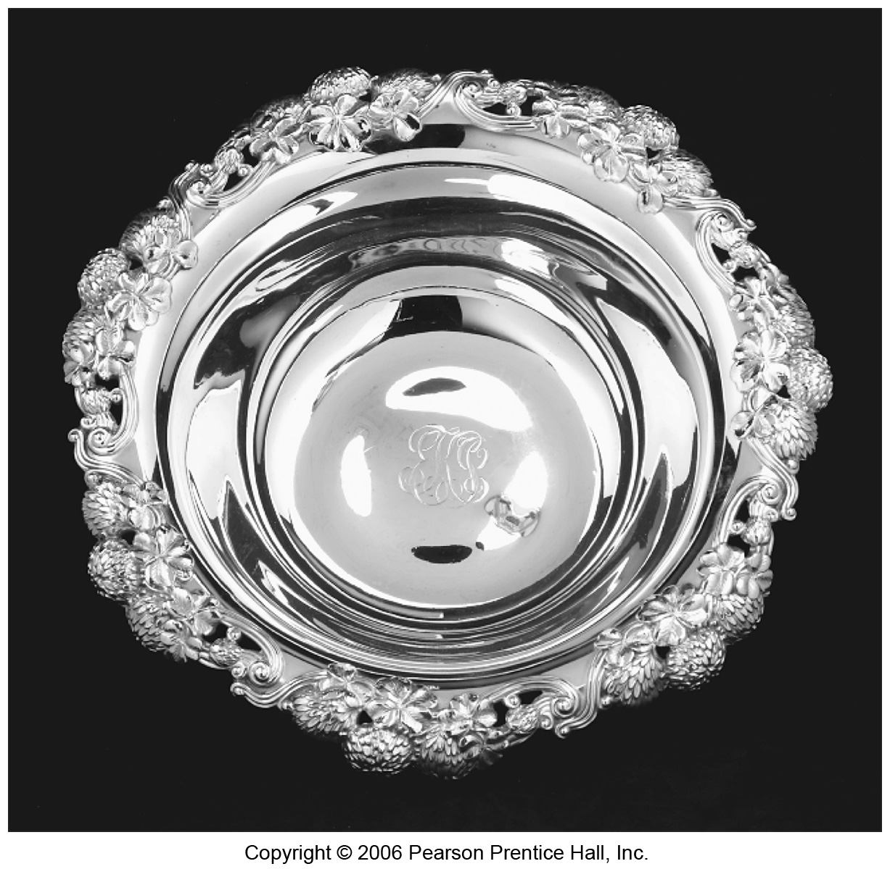
Metals
Tend to be lustrous, malleable, ductile, and good conductors of heat and electricity.

Slide 39
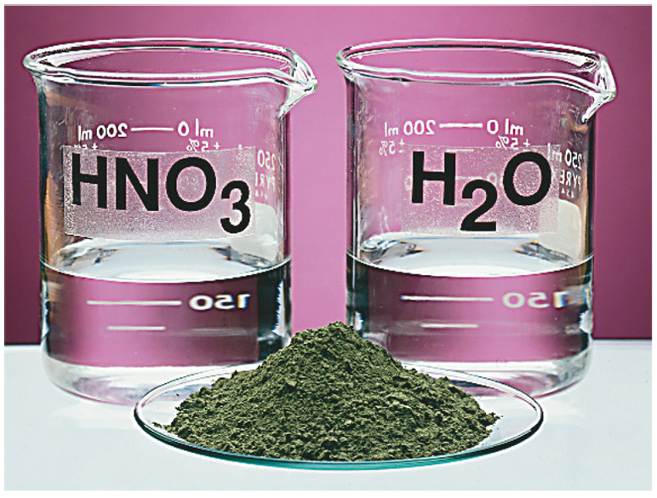
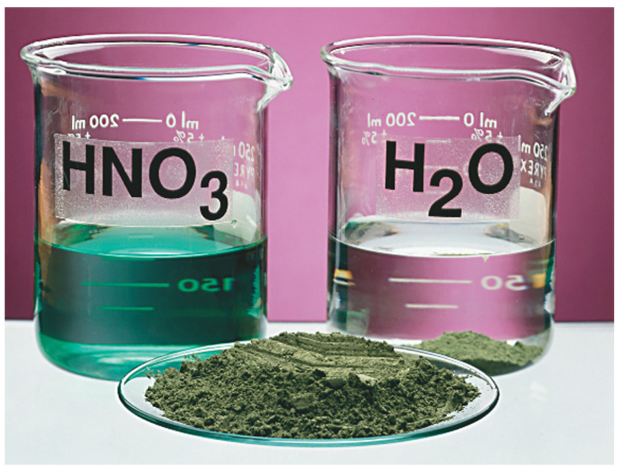
Metals
Compounds formed between metals and nonmetals tend to be ionic.
Metal oxides tend to be basic.

Slide 40
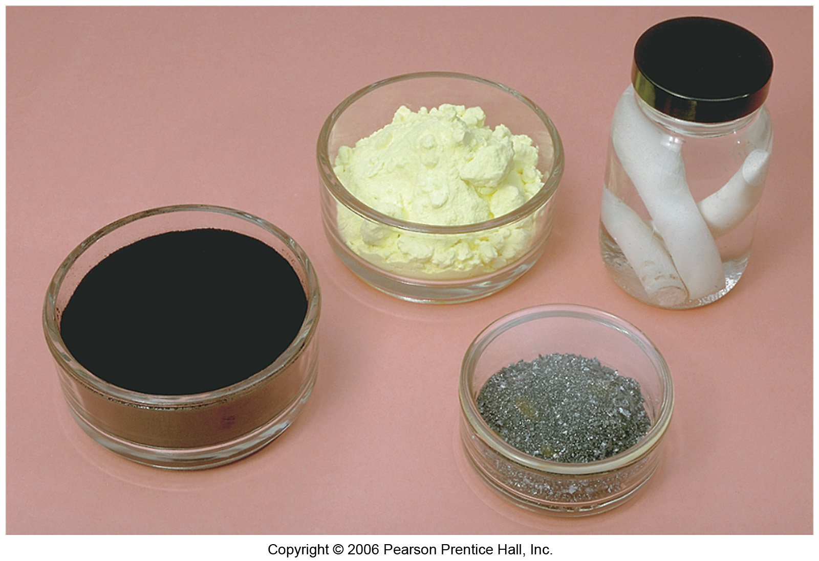
Nonmetals
Dull, brittle substances that are poor conductors of heat and electricity.
Tend to gain electrons in reactions with metals to acquire noble gas configuration.

Slide 41
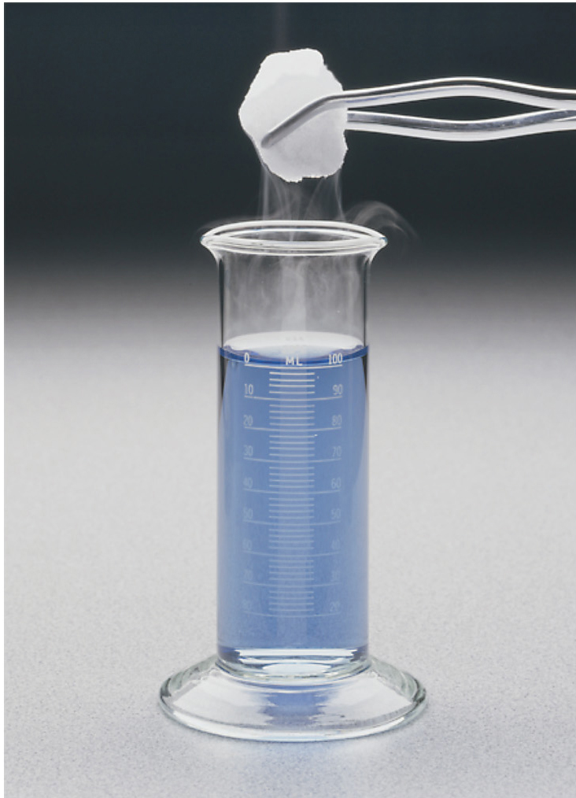
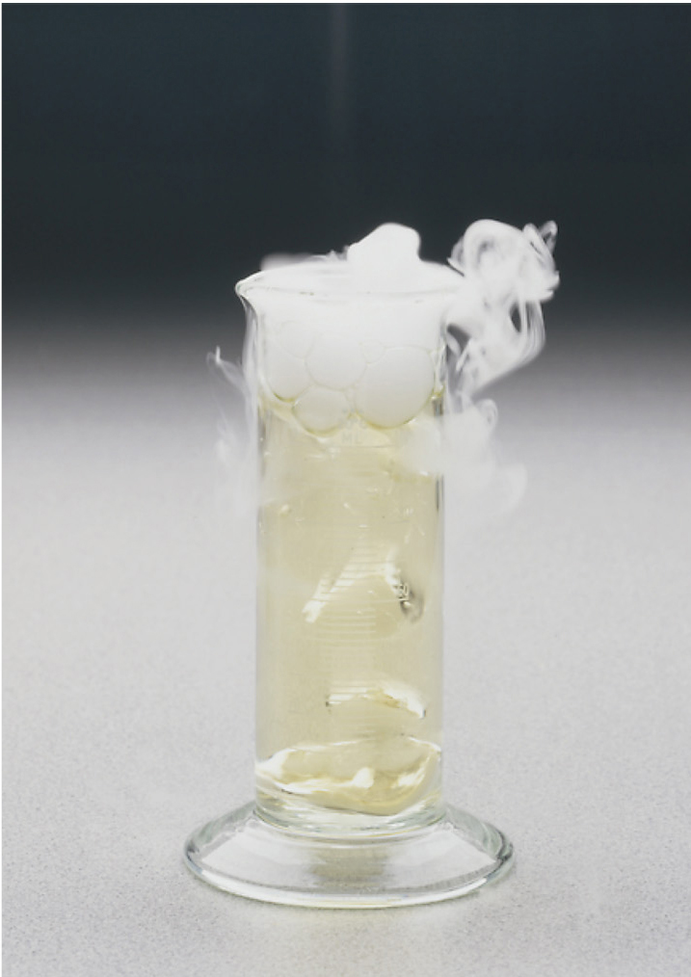
Nonmetals
Substances containing only nonmetals are molecular compounds.
Most nonmetal oxides are acidic.

Slide 42
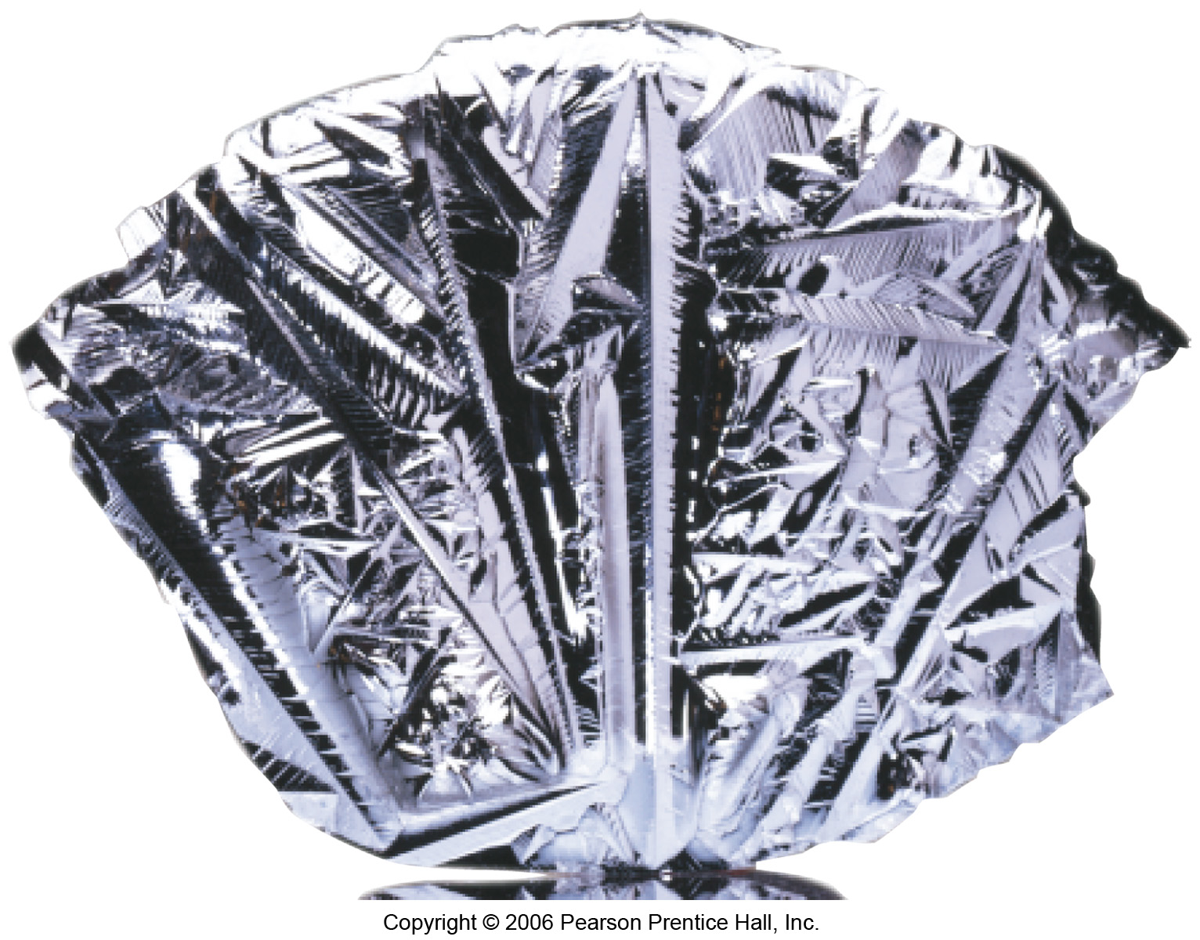
Metalloids
Have some characteristics of metals, some of nonmetals.
For instance, silicon looks shiny, but is brittle and fairly poor conductor.

Slide 43
Group Trends

Slide 44
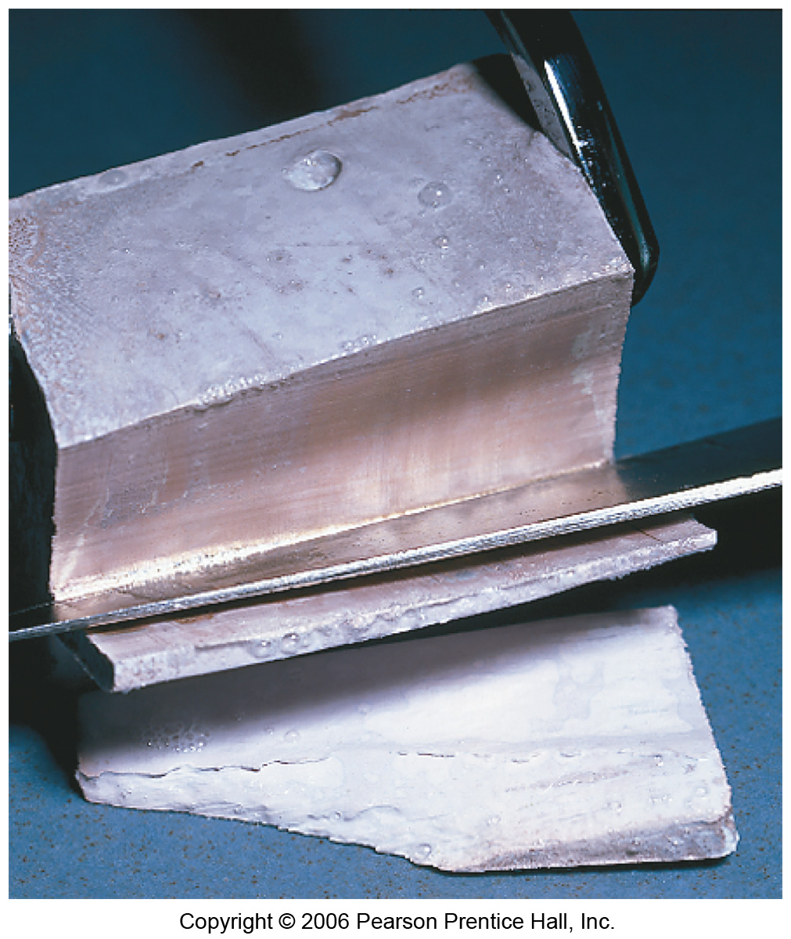
Alkali Metals
Soft, metallic solids.
Name comes from Arabic word for ashes.

Slide 45
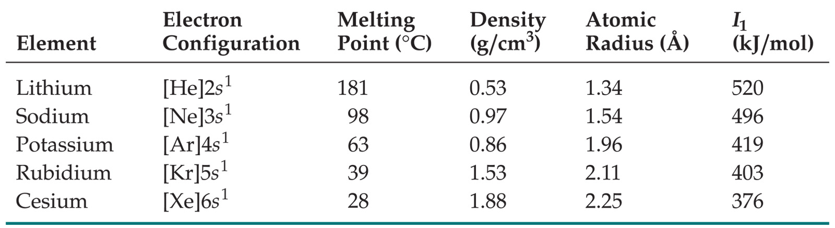
Alkali Metals
Found only as compounds in nature.
Have low densities and melting points.
Also have low ionization energies.

Slide 46
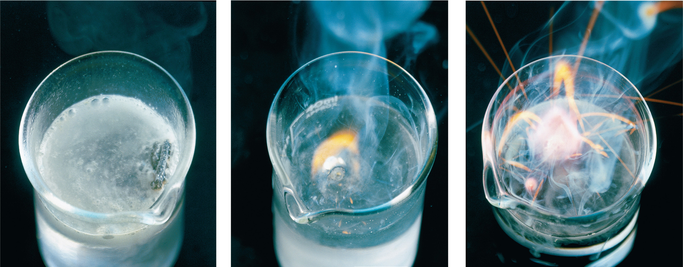
Alkali Metals
Their reactions with water are famously exothermic.

Slide 47
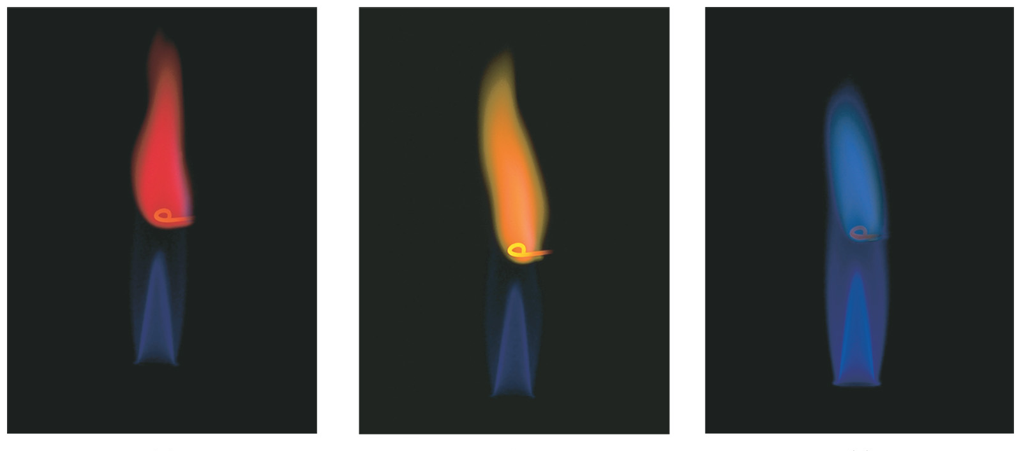
Alkali Metals
Alkali metals (except Li) react with oxygen to form peroxides.
K, Rb, and Cs also form superoxides:
K + O₂ ⎯⎯→ KO₂
Produce bright colors when placed in flame.

Slide 48
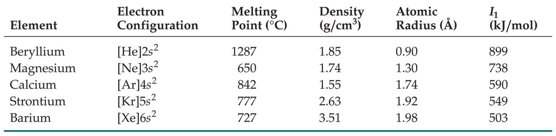
Alkaline Earth Metals
Have higher densities and melting points than alkali metals.
Have low ionization energies, but not as low as alkali metals.

Slide 49
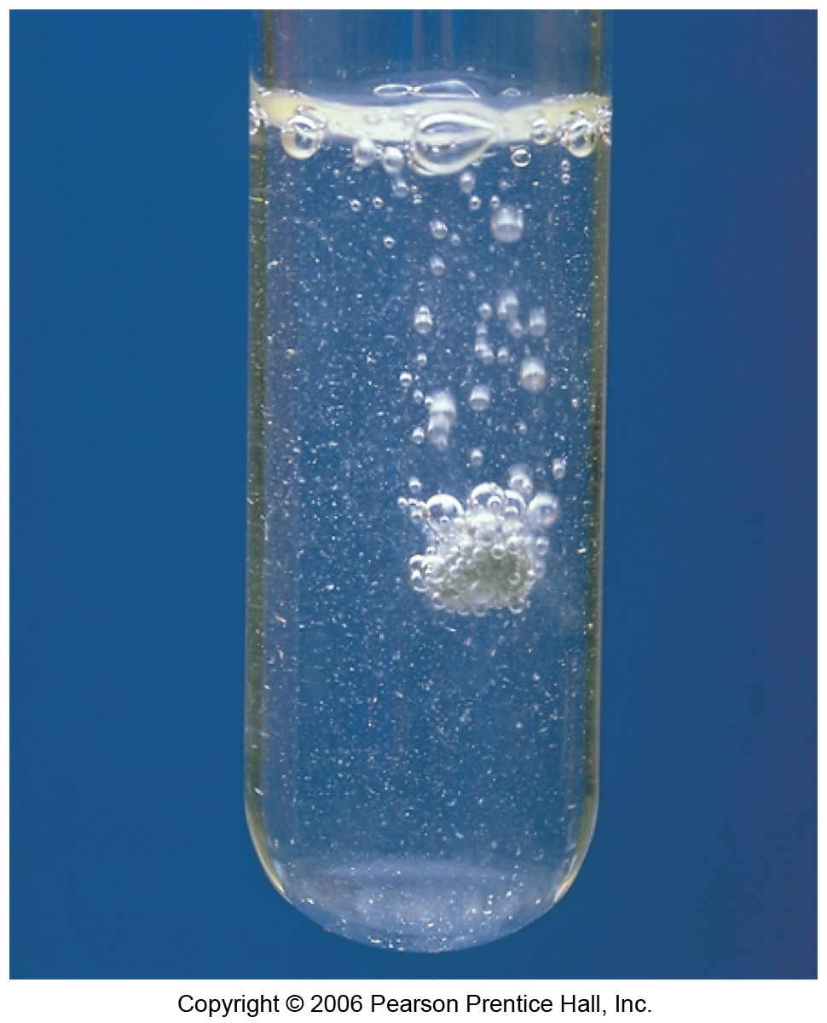
Alkaline Earth Metals
Be does not react with water, Mg reacts only with steam, but others react readily with water.
Reactivity tends to increase as go down group.

Slide 50
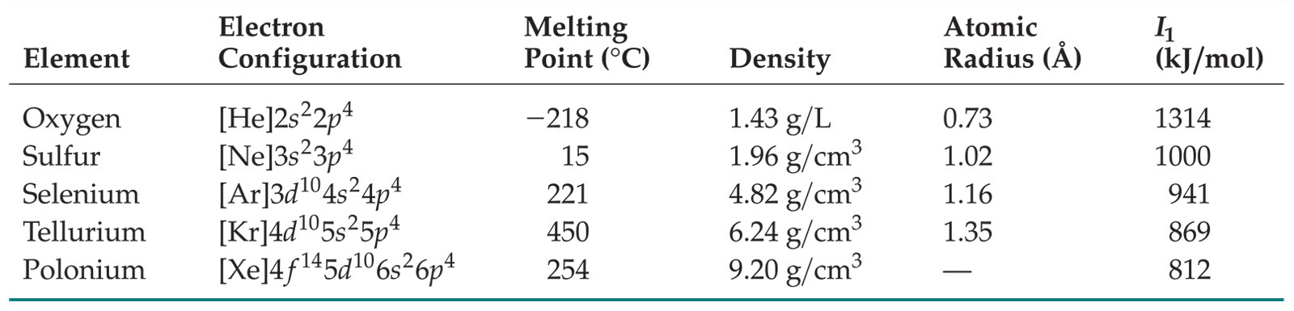
Group 6A
Oxygen, sulfur, and selenium are nonmetals.
Tellurium is a metalloid.
The radioactive polonium is a metal.

Slide 51
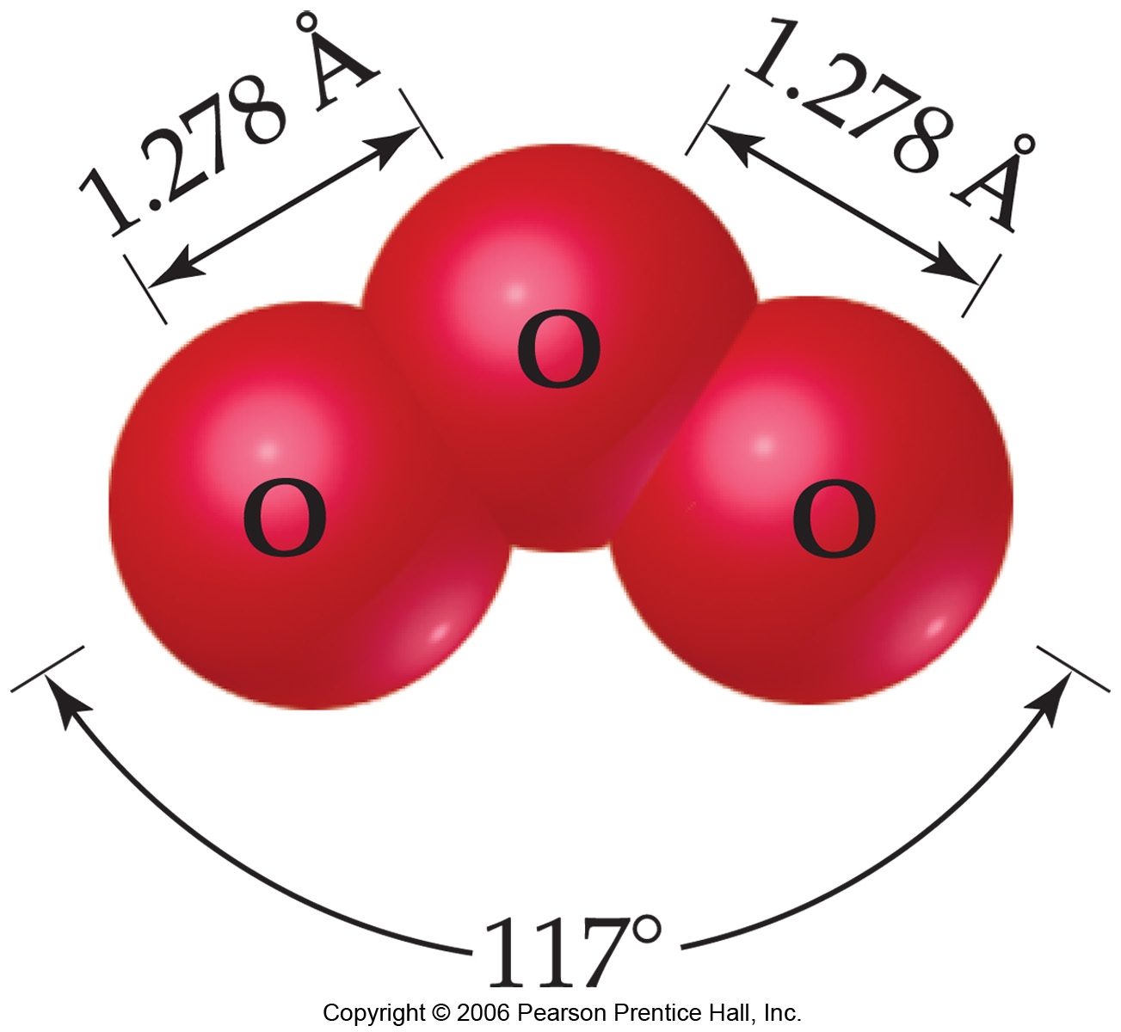
Oxygen
Two allotropes:
O₂
O₃, ozone
Three anions:
O²⁻, oxide
O₂²⁻, peroxide
O₂¹⁻, superoxide
Tends to take electrons from other elements (oxidation)

Slide 52
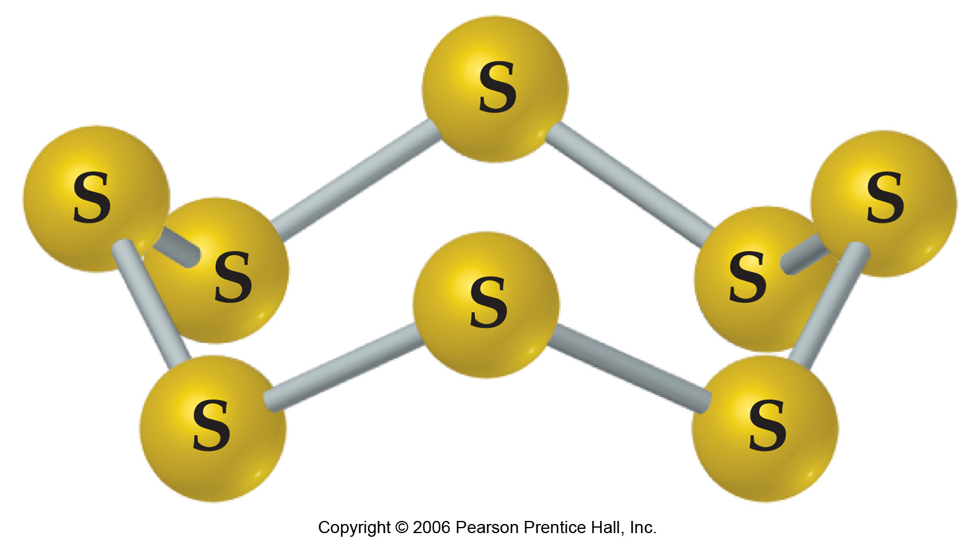
Sulfur
Weaker oxidizing agent than oxygen.
Most stable allotrope is S₈, a ringed molecule.

Slide 53
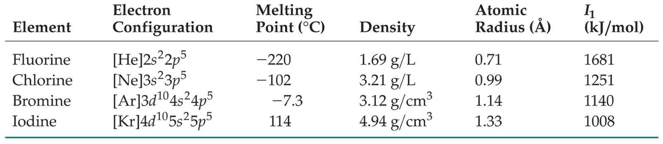
Group VIIA: Halogens
Prototypical nonmetals
Name comes from the Greek halos and gennao: “salt formers”

Slide 54
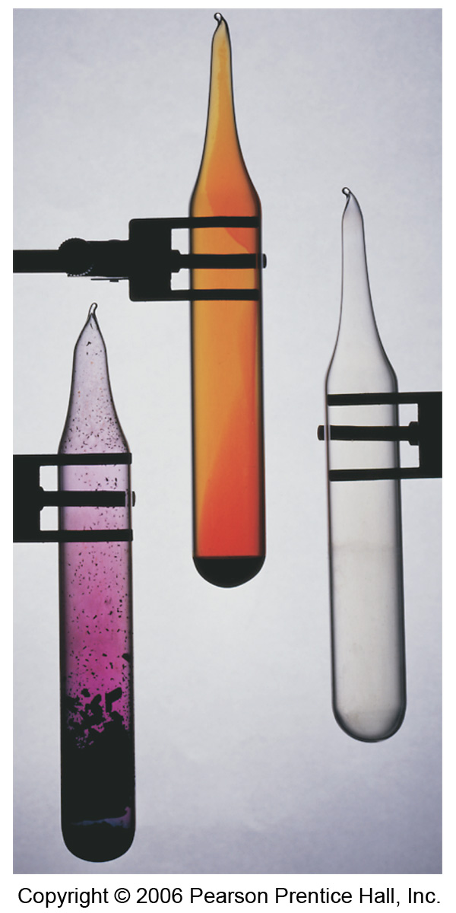
Group VIIA: Halogens
Large, negative electron affinities
Therefore, tend to oxidize other elements easily
React directly with metals to form metal halides
Chlorine added to water supplies to serve as disinfectant

Slide 55
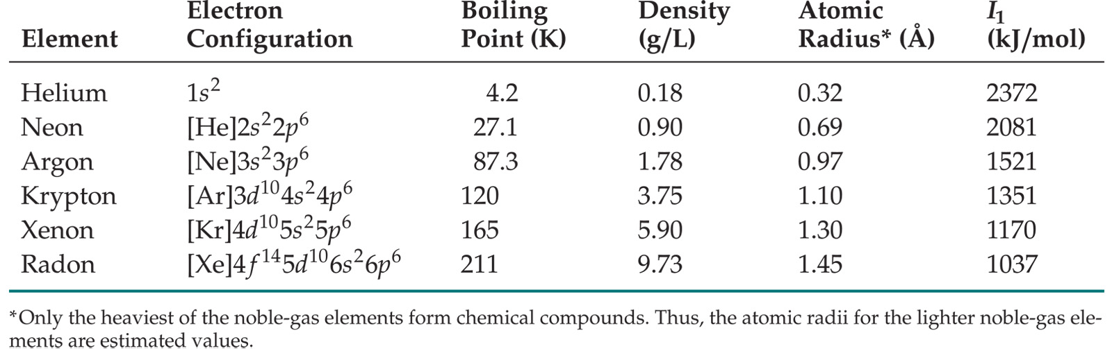
Group VIIIA: Noble Gases
Astronomical ionization energies
Positive electron affinities
Therefore, relatively unreactive
Monatomic gases

Slide 56
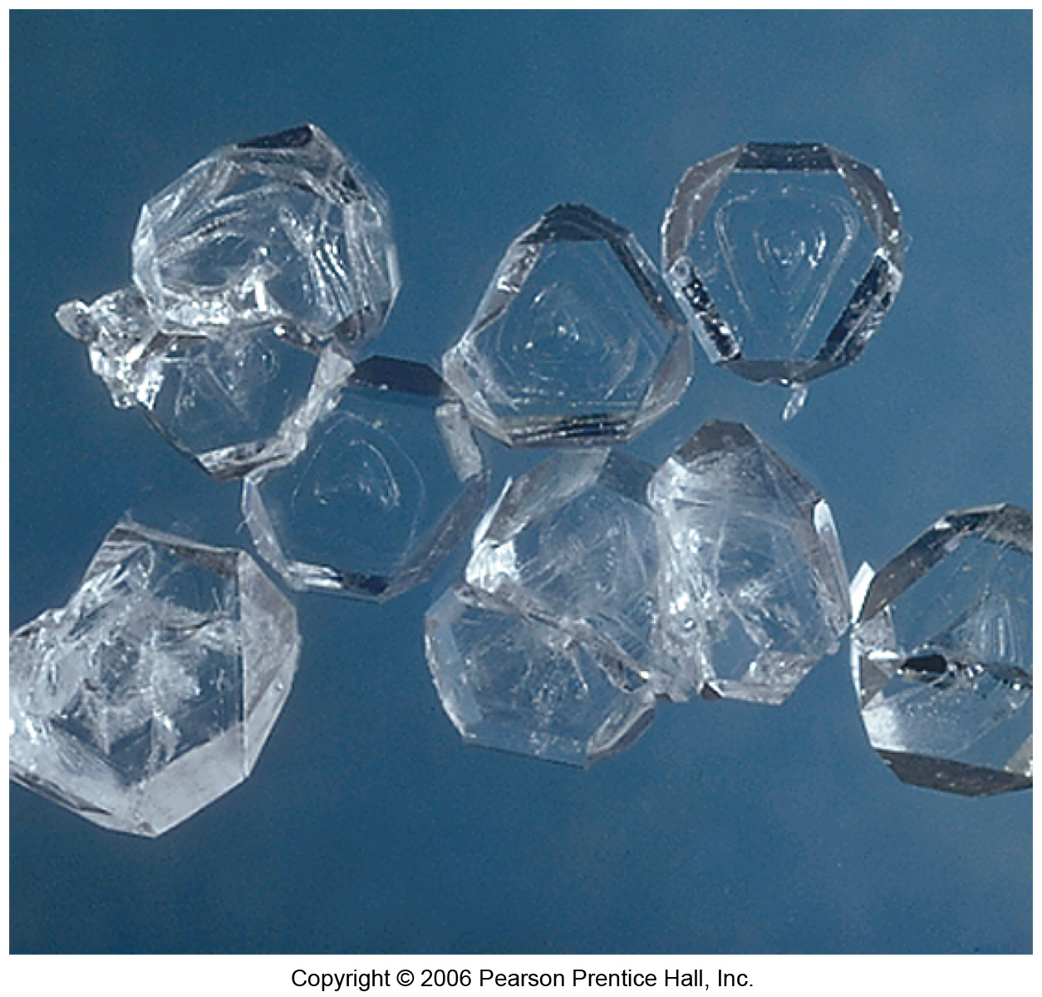
Group VIIIA: Noble Gases
Xe forms three compounds:
XeF₂
XeF₄ (at right)
XeF₆
Kr forms only one stable compound:
KrF₂
The unstable HArF was synthesized in 2000.

Slide 57
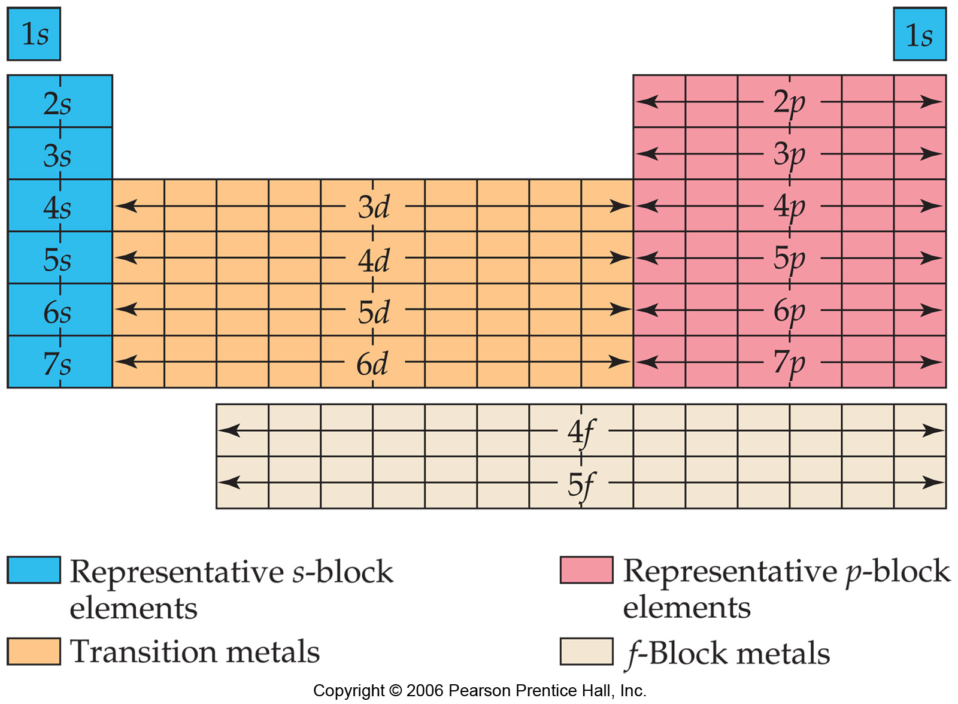

Slide 58
Periodic trends
Effective nuclear charge
trends in atomic radius
trends in ion radius
Ionization energy, trends
electron affinity, trends.

